Slide 1
Mysql data analysis course
Mid Course Assignment Result Presentation
Presented by Pathompon Moonthianngam

Slide 2
Mid course assignment

Slide 3
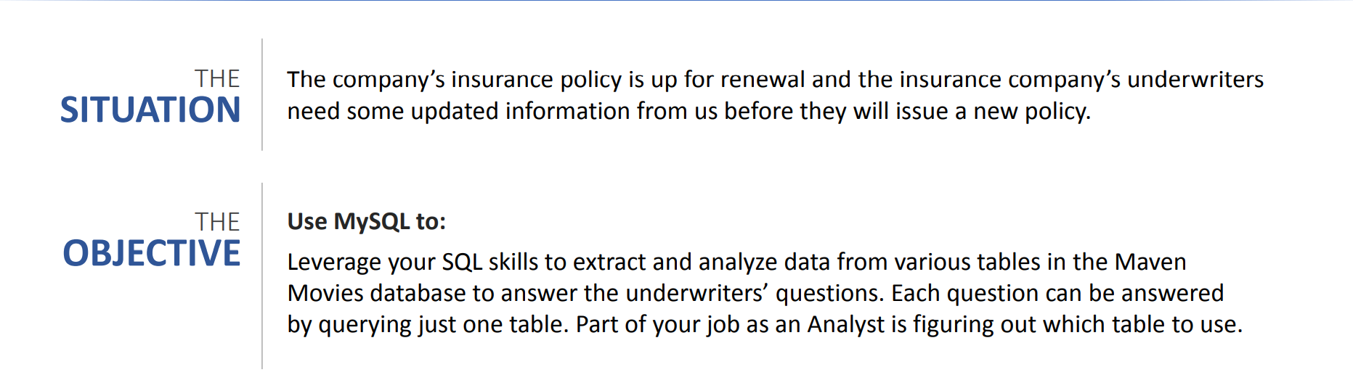
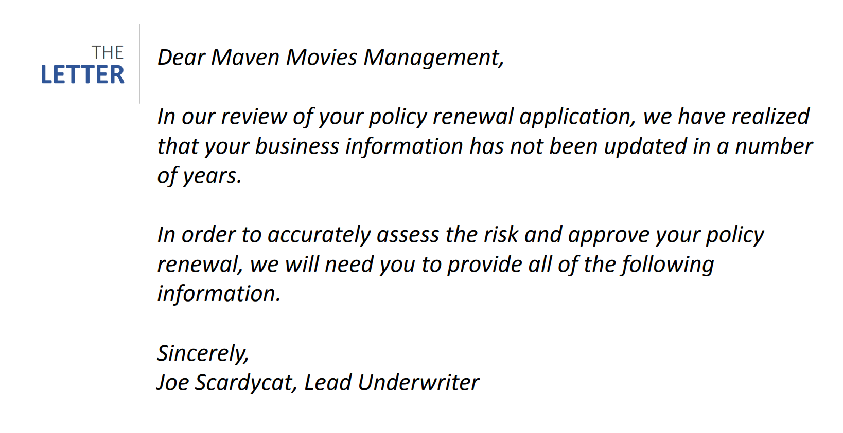

Mid Course Assignment

Slide 4
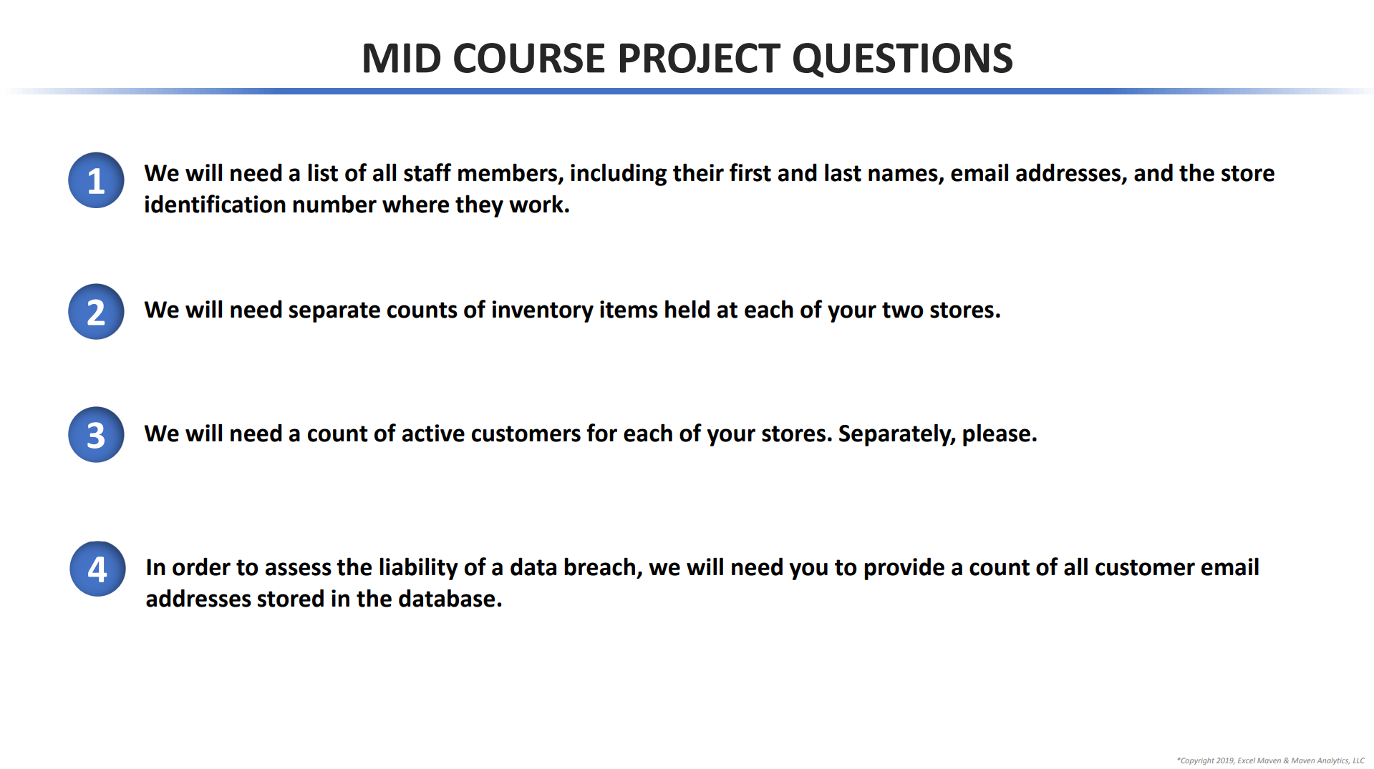

Slide 5
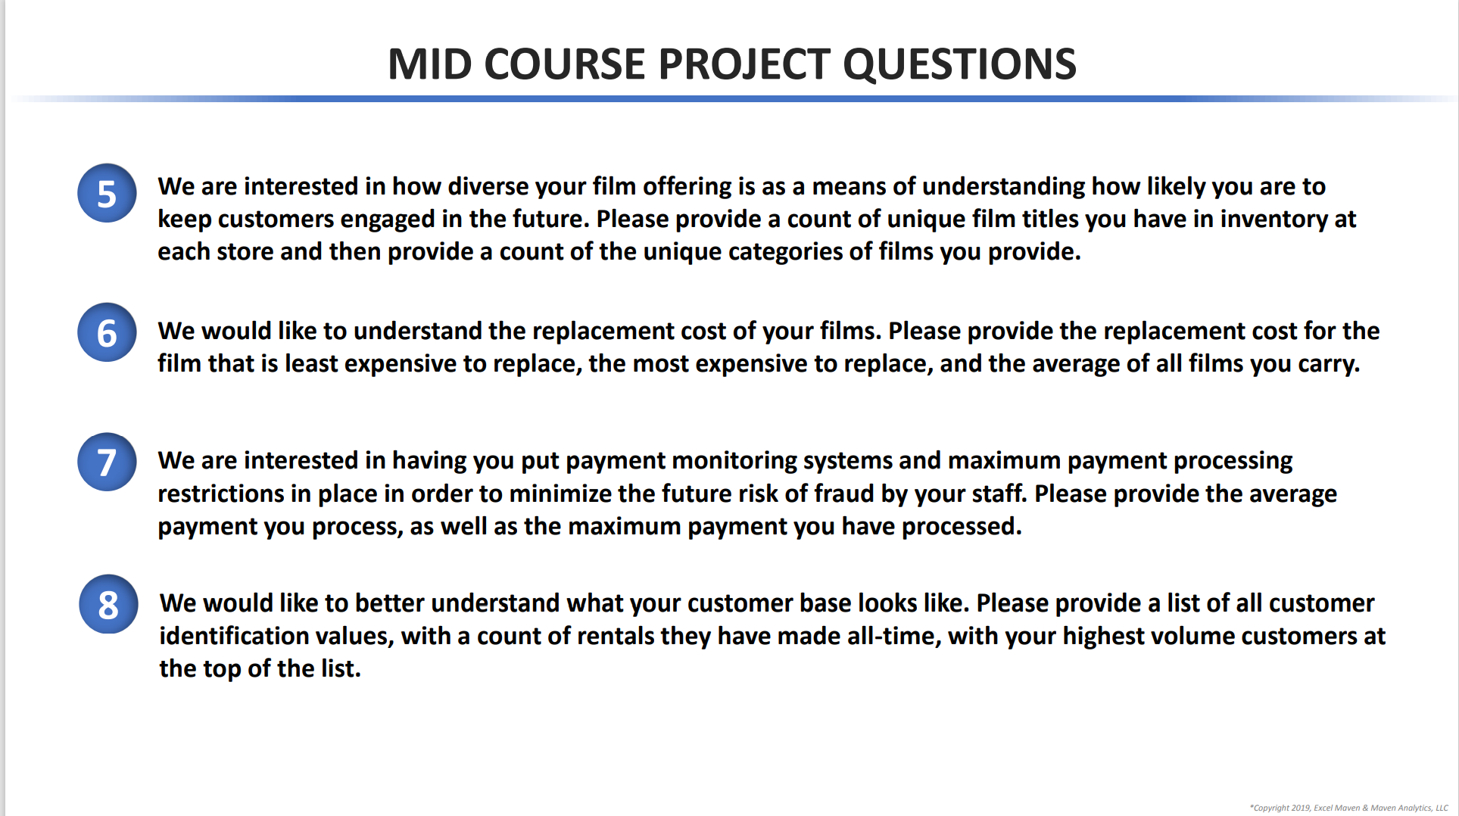

Slide 6
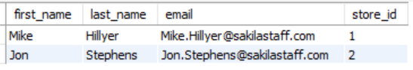

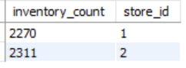
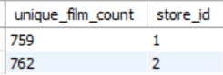
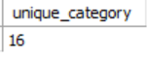
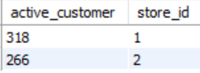
Following the Underwriter’s request, we found…
Store 1 and 2 are staffed by Mike H. and Jon S., respectively.
Store 2 has more inventory, specifically more films across 16 categories, than Store 1 but has fewer active customers.

Slide 7

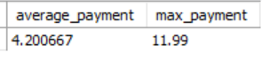
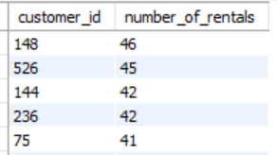
In addition. . .
The most expensive film replacement cost was $29.99.
The average payment the stores processed was $4.20.
The most that one customer had rented was 46 films.
See full csv file on Github

